Slide 1
iOPEX Test Plyale

Slide 2

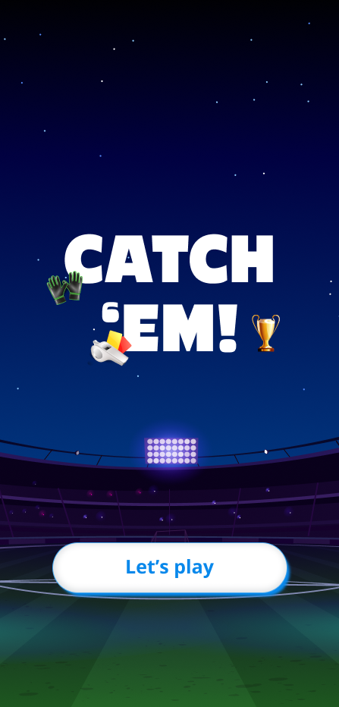
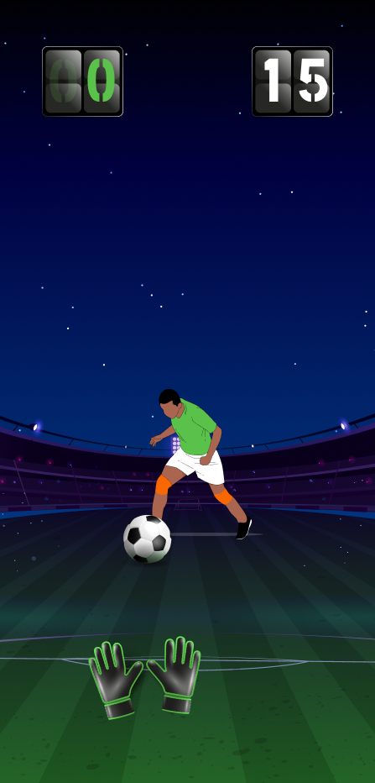
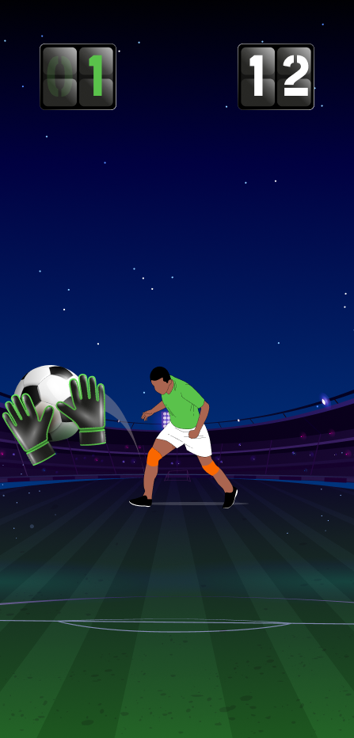
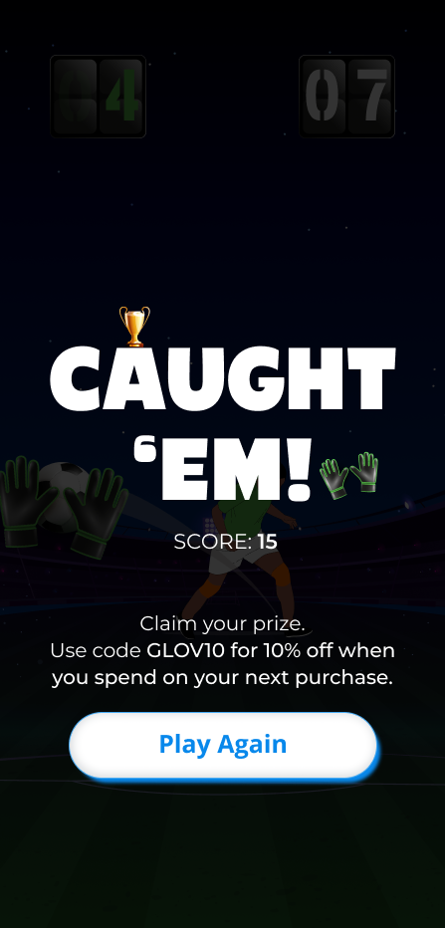
Catching game
Concept: Tap the screen every time a soccer ball comes flying at you. You’ve got your gloves and 3 chances—miss more than that, it’s game over! And don’t forget, the clock is ticking—catch as many balls as you can before time runs out.
Use cases: Good ratio of CTA Clicks Higher Game Start to Complete Ratio
Good session duration
Better Engagement

